Slide 1
Performance evaluation of Java for numerical computing
Roldan Pozo
Leader, Mathematical Software Group
National Institute of Standards and Technology

Slide 2
Background: Where we are coming from...
National Institute of Standards and Technology
  US Department of Commerce
  NIST (3,000 employees, mainly scientists and engineers)
middle to large-scale simulation modeling
mainly Fortran , C/C++ applications
utilize many tools: Matlab, Mathematica, Tcl/Tk, Perl, GAUSS, etc.
typical arsenal: IBM SP2, SGI/ Alpha/PC clusters

Slide 3
Mathematical & Computational Sciences Division
Algorithms for simulation and modeling
High performance computational linear algebra
Numerical solution of PDEs
Multigrid and hierarchical methods
Numerical Optimization
Special Functions
Monte Carlo simulations

Slide 4
Java Landscape
Programming language
  general-purpose object oriented
Standard runtime system
  Java Virtual Machine
API Specifications
  AWT, Java3D, JBDC, etc.
JavaBeans, JavaSpaces, etc.
Verification
  100% Pure Java

Slide 5
Example: Successive Over-Relaxation
public static final void SOR(double omega, double G[][], int num_iterations)
{
int M = G.length;
int N = G[0].length;
double omega_over_four = omega * 0.25;
double one_minus_omega = 1.0 - omega;
for (int p=0; p<num_iterations; p++) {
for (int i=1; i<M-1; i++) {
for (int j=1; j<N-1; j++)
G[i][j] = omega_over_four * (G[i-1][j] + Gi[i+1][j] +
G[i][j-1] + G[i][j+1]) + one_minus_omega * Gi[j];
}
}
}

Slide 6
Why Java?
Portability of the Java Virtual Machine (JVM)
Safe, minimize memory leaks and pointer errors
Network-aware environment
Parallel and Distributed computing
  Threads
  Remote Method Invocation (RMI)
Integrated graphics
Widely adopted
  embedded systems, browsers, appliances
  being adopted for teaching, development

Slide 7
Portability
Binary portability is Java’s greatest strength
  several million JDK downloads
  Java developers for intranet applications greater than C, C++, and Basic combined
JVM bytecodes are the key
Almost any language can generate Java bytecodes
Issue:
  can performance be obtained at bytecode level?

Slide 8
Why not Java?
Performance
  interpreters too slow
  poor optimizing compilers
  virtual machine

Slide 9
Why not Java?
lack of scientific software
  computational libraries
  numerical interfaces
  major effort to port from f77/C

Slide 10
Performance

Slide 11
What are we really measuring?
language vs. virtual machine (VM)
Java -> bytecode translator
bytecode execution (VM)
  interpreted
  just-in-time compilation (JIT)
  adaptive compiler (HotSpot)
underlying hardware

Slide 12
Making Java fast(er)
Native methods (JNI)
stand-alone compliers (.java -> .exe)
modified JVMs
  (fused mult-adds, bypass array bounds checking)
aggressive bytecode optimization
  JITs, flash compilers, HotSpot
bytecode transformers
concurrency

Slide 13
Computational Linear Algebra
Time-consuming portion of PDE solvers and optimization problems
basic matrix/vector operations (BLAS) often comprise major portion of cycles
key: optimize BLAS

Slide 14

Matrix multiply
(100% Pure Java)
*Pentium II I 500Mhz; java JDK 1.2 (Win98)

Slide 15
Optimizing Java linear algebra
Use native Java arrays: A[][]
algorithms in 100% Pure Java
exploit
  multi-level blocking
  loop unrolling
  indexing optimizations
  maximize on-chip / in-cache operations
can be done today with javac, jview, J++, etc.

Slide 16
Matrix Multiply: data blocking
1000x1000 matrices (out of cache)
Java: 181 Mflops
2-level blocking:
  40x40 (cache)
  8x8 unrolled (chip)
subtle trade-off between more temp variables and explicit indexing
block size selection important: 64x64 yields only 143 Mflops
*Pentium III 500Mhz; Sun JDK 1.2 (Win98)

Slide 17
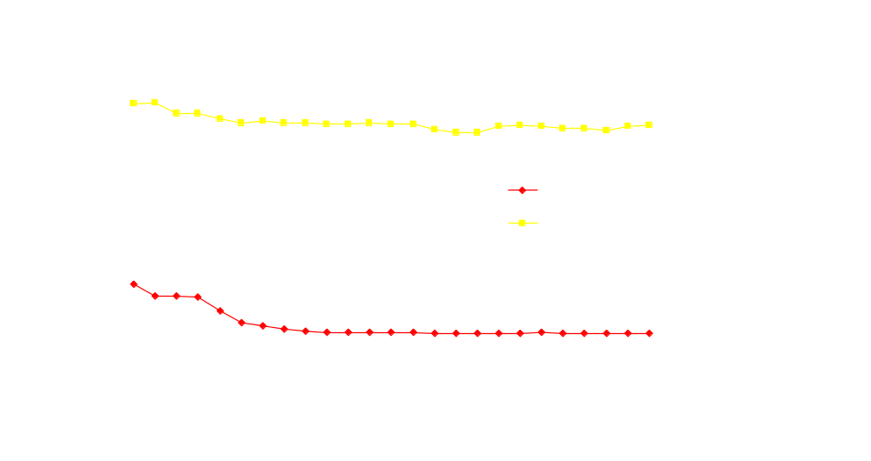
Matrix multiply optimized
(100% Pure Java)
*Pentium II I 500Mhz; java JDK 1.2 (Win98)

Slide 18
Sparse Matrix Computations
unstructured pattern
coordinate storage (CSR/CSC)
array bounds check cannot be optimized away

Slide 19
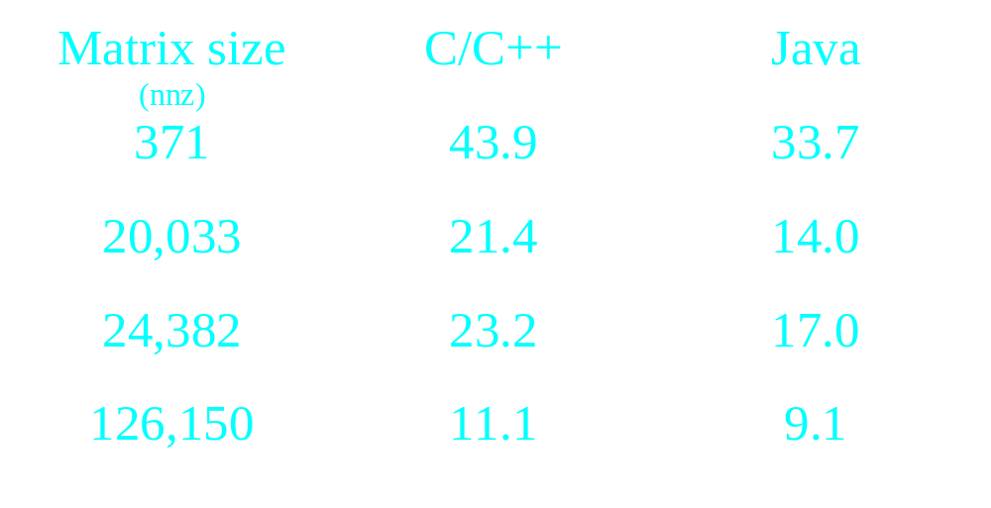
Sparse matrix/vector Multiplication
(Mflops)
*266 MHz PII, Win95: Watcom C 10.6, Jview (SDK 2.0)

Slide 20
Java Benchmarking Efforts
Caffine Mark
SPECjvm98
Java Linpack
Java Grande Forum Benchmarks
SciMark
Image/J benchmark
BenchBeans
VolanoMark
Plasma benchmark
RMI benchmark
JMark
JavaWorld benchmark
...

Slide 21
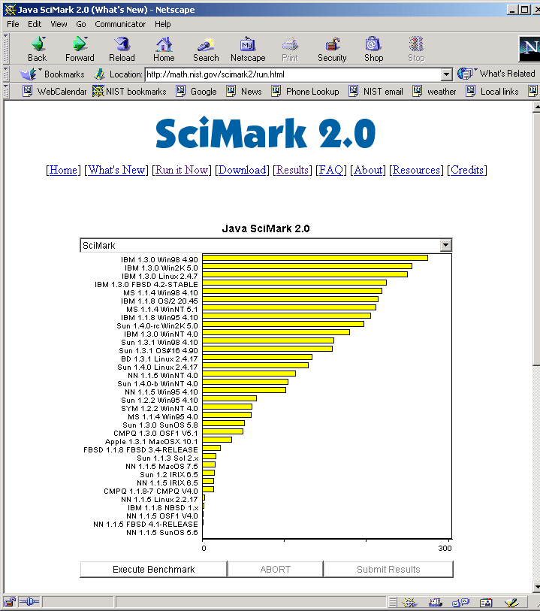

Slide 22
SciMark Benchmark
Numerical benchmark for Java, C/C++
composite results for five kernels:
  FFT (complex, 1D)
  Successive Over-relaxation
  Monte Carlo integration
  Sparse matrix multiply
  dense LU factorization
results in Mflops
two sizes: small, large
Notes:
sequential, no threads
look at SMP version soon
verifies subset computations (LU, FFT)
auto-tunes experiment repetitions
100% Pure Java / ANSI C
source code available
universal metric (Mflops)

Slide 23
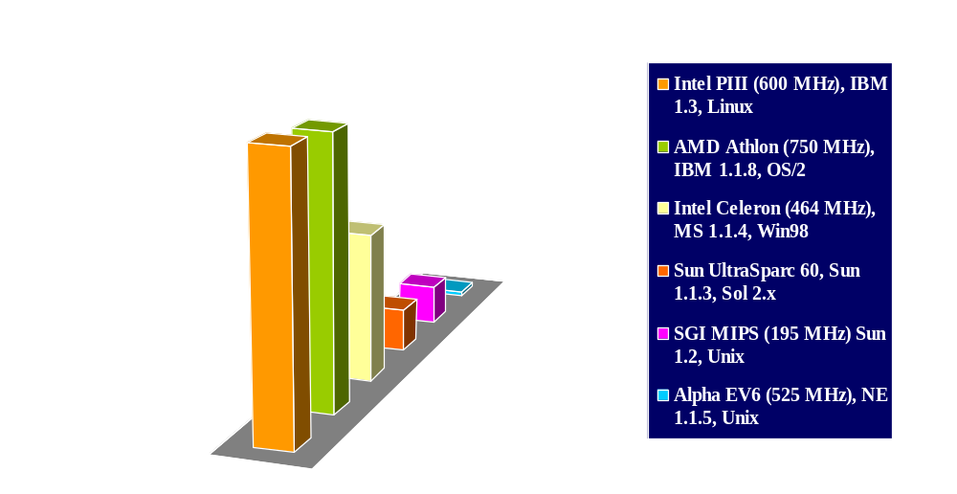
SciMark 2.0 results

Slide 24

JVMs have improved over time
SciMark : 333 MHz Sun Ultra 10

Slide 25
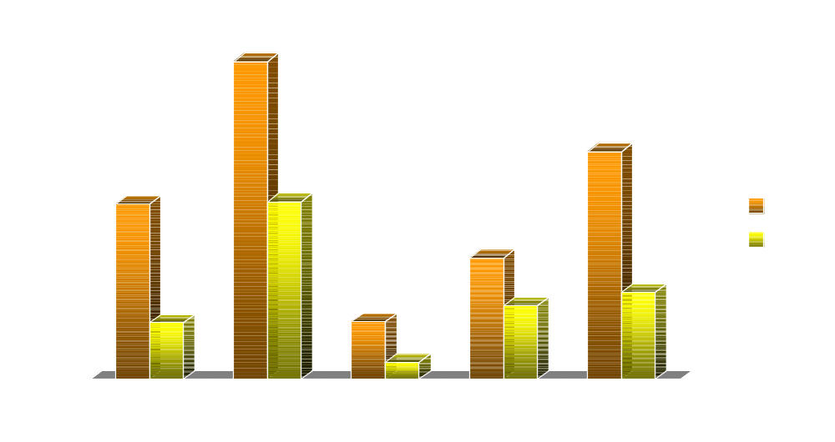
SciMark: Java vs. C
(Sun UltraSPARC 60)
* Sun JDK 1.3 (HotSpot) , javac -0; Sun cc -0; SunOS 5.7

Slide 26
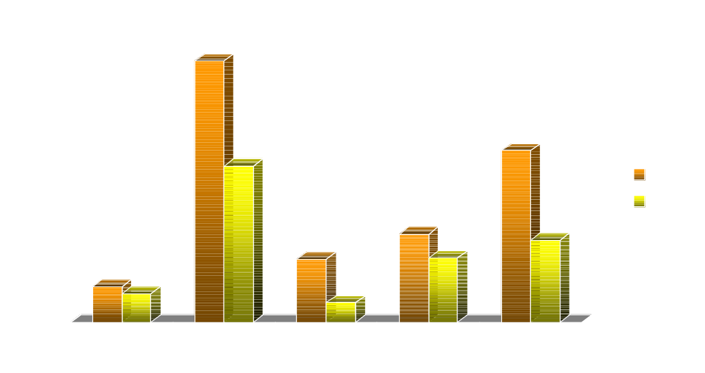
SciMark (large): Java vs. C
(Sun UltraSPARC 60)
* Sun JDK 1.3 (HotSpot) , javac -0; Sun cc -0; SunOS 5.7

Slide 27
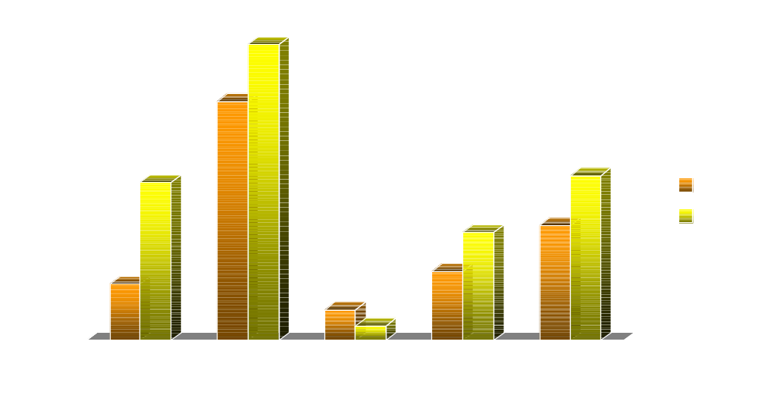
SciMark: Java vs. C
(Intel PIII 500MHz, Win98)
* Sun JDK 1.2, javac -0; Microsoft VC++ 5.0, cl -0; Win98

Slide 28
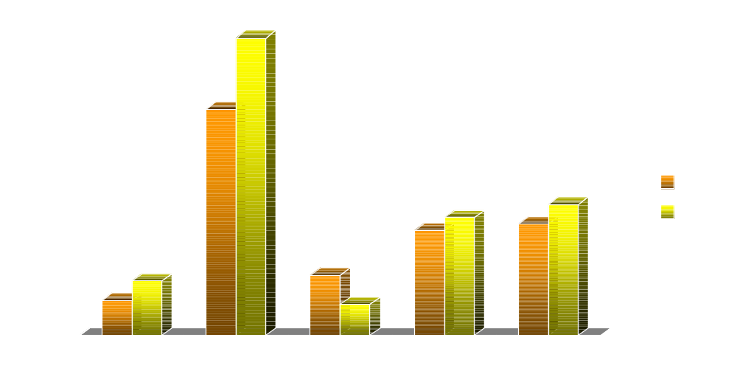
SciMark (large): Java vs. C
(Intel PIII 500MHz, Win98)
* Sun JDK 1.2, javac -0; Microsoft VC++ 5.0, cl -0; Win98

Slide 29
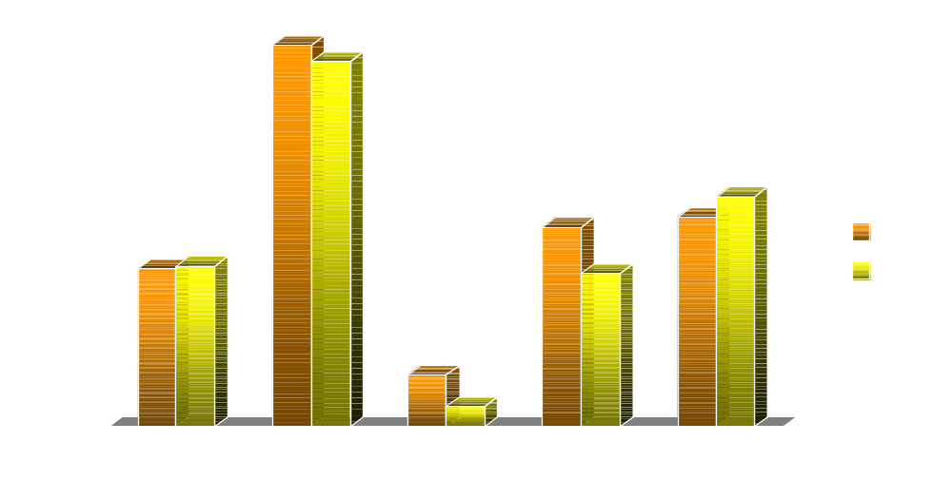
SciMark: Java vs. C
(Intel PIII 500MHz, Linux)
* RH Linux 6.2, gcc (v. 2.91.66) -06, IBM JDK 1.3, javac -O

Slide 30

SciMark results
500 MHz PIII (Mflops)
*500MHz PIII, Microsoft C/C++ 5.0 (cl -O2x -G6), Sun JDK 1.2, Microsoft JDK 1.1.4, IBM JRE 1.1.8

Slide 31
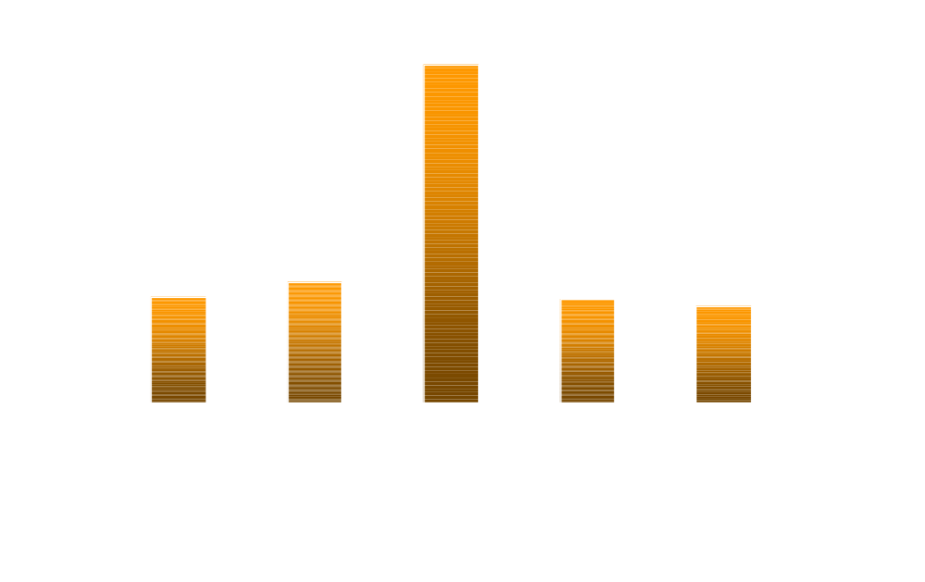
SciMark FFT results
Intel 500MHz PIII (Mflops)
*500MHz PIII, Microsoft C/C++ 5.0 (cl -O2x -G6), Sun JDK 1.2, Microsoft JDK 1.1.4, IBM JRE 1.1.8

Slide 32

SciMark SOR results
(Mflops)
*500MHz PIII, Microsoft C/C++ 5.0 (cl -O2x -G6), Sun JDK 1.2, Microsoft JDK 1.1.4, IBM JRE 1.1.8

Slide 33

SciMark Monte Carlo results
(Mflops)
*500MHz PIII, Microsoft C/C++ 5.0 (cl -O2x -G6), Sun JDK 1.2, Microsoft JDK 1.1.4, IBM JRE 1.1.8

Slide 34

SciMark Sparse-Matmult results
(Mflops)
*500MHz PIII, Microsoft C/C++ 5.0 (cl -O2x -G6), Sun JDK 1.2, Microsoft JDK 1.1.4, IBM JRE 1.1.8

Slide 35

SciMark LU results
(Mflops)
*500MHz PIII, Microsoft C/C++ 5.0 (cl -O2x -G6), Sun JDK 1.2, Microsoft JDK 1.1.4, IBM JRE 1.1.8

Slide 36
C vs. Java
Why C is faster than Java
  direct mapping to hardware
  more opportunities for aggressive optimization
  no garbage collection
Why Java is faster than C (?)
  different compilers/optimizations
  performance more a factor of economics than technology
  PC compilers aren’t tuned for numerics

Slide 37
Current JVMs are quite good...
Scimark high score: 275 Mflops*
  FFT: 274 Mflops
  Jacobi: 350 Mflops
  Monte Carlo: 39 Mflops
  Sparse matmult: 239
  LU factorization: 496 Mflops
  * 1.5 GHz AMD Athlon, IBM 1.3.0, Linux

Slide 38
Another approach...
Use an aggressive optimizing compiler
code using Array classes which mimic Fortran storage
  e.g. A[i][j] becomes A.get(i,j)
  ugly, but can be fixed with operator overloading extensions
exploit hardware (FMAs)
result: 85+% of Fortran on RS/6000

Slide 39
IBM High Performance Compiler
Snir, Moreria, et. al
native compiler (.java -> .exe)
requires source code
can’t embed in browser, but…
produces very fast codes

Slide 40
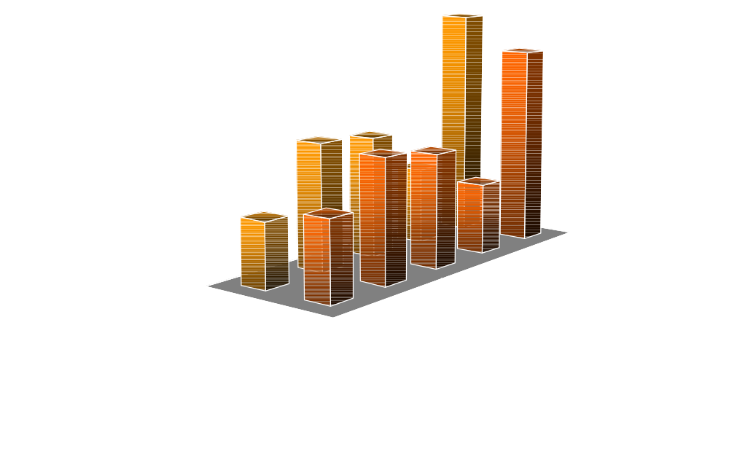
Java vs. Fortran Performance
*IBM RS/6000 67MHz POWER2 (266 Mflops peak) AIX Fortran, HPJC

Slide 41
Yet another approach...
HotSpot
  Sun Microsystems
Progressive profiler/compiler
trades off aggressive compilation/optimization at code bottlenecks
quicker start-up time than JITs
tailors optimization to application

Slide 42
Concurrency
Java threads
  runs on multiprocessors in NT, Solaris, AIX
  provides mechanisms for locks, synchornization
  can be implemented in native threads for performance
  no native support for parallel loops, etc.

Slide 43
Concurrency
Remote Method Invocation (RMI)
  extension of RPC
  high-level than sockets/network programming
  works well for functional parallelism
  works poorly for data parallelism
  serialization is expensive
  no parallel/distribution tools

Slide 44
Numerical Software
(Libraries)

Slide 45
Scientific Java Libraries
Matrix library (JAMA)
  NIST/Mathworks
  LU, QR, SVD, eigenvalue solvers
Java Numerical Toolkit (JNT)
  special functions
  BLAS subset
Visual Numerics
  LINPACK
  Complex
IBM
  Array class package
Univ. of Maryland
  Linear Algebra library
JLAPACK
  port of LAPACK

Slide 46
Java Numerics Group
industry-wide consortium to establish tools, APIs, and libraries
  IBM, Intel, Compaq/Digital, Sun, MathWorks, VNI, NAG
  NIST, Inria
  Berkeley, UCSB, Austin, MIT, Indiana
component of Java Grande Forum
  Concurrency group

Slide 47
Numerics Issues
complex data types
lightweight objects
operator overloading
generic typing (templates)
IEEE floating point model

Slide 48
Parallel Java projects
Java-MPI
JavaPVM
Titanium (UC Berkeley)
HPJava
DOGMA
JTED
Jwarp
DARP
Tango
DO!
Jmpi
MpiJava
JET Parallel JVM

Slide 49
Conclusions
Java’s biggest strength for scientific computing: binary portability
Java numerics performance is competitive
  can achieve efficiency of optimized C/Fortran
best Java performance on commodity platforms
improving Java numerics even further:
  integrate array and complex into Java
  more libraries

Slide 50
Scientific Java Resources
Java Numerics Group
  http://math.nist.gov/javanumerics
Java Grande Forum
  http://www.javagrade.org
SciMark Benchmark
  http://math.nist.gov/scimark

